Slide 1


Creating surge capacity to respond to COVID-19
Overview of WHO tools
1 April 2020
Cris Scotter | Snr Advisor/Consultant | DSP

Slide 2
What is surge capacity?
"Surge capacity is the ability of the health system to manage a sudden and unexpected influx of patients in a disaster or emergency situation. Surge capacity can be created and it involves a comprehensive approach linking the 4 S’s of surge"
Space
Staff
Supplies
Systems
Linked WHO products to support MS
Surge calculators to estimate capacity needs
Technical guidance note to outline policy options
Action check-lists

Slide 3
Available tools
Adappt Surge Planning Support Tool
Contact – Cris Scotter
COVID-19 Workforce Estimator
Contact – Cris Scotter
WHO COVID-19 Essential Supplies Forecasting Tool
Contact - Guillaume Queyras

Slide 4
Which tool?
Slightly different utility and target audience
 | MAIN purpose (Which "S"?) | Target audience | Developer
Adaptt Surge Planning Support Tool | Space, Staff | High-level policy makers with at-a-glance approach | EURO/DSP & HQ
COVID-19 Workforce estimator | Staff | Planners at national, regional, facility levels | EURO/DSP & HQ
Essential Supplies Forecasting Tool | Space, supplies | Planners at national, regional levels | HQ/OSL

Slide 5

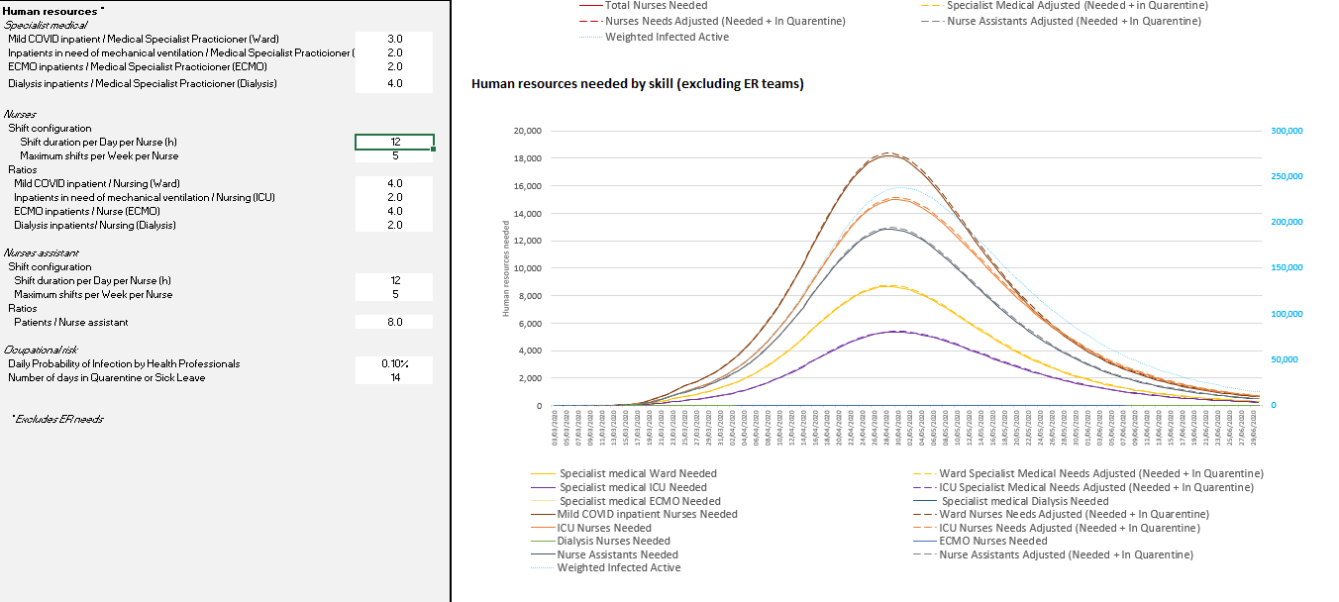
Adappt Surge Planning Support Tool

Slide 6
Adappt Outputs
The Adappt SPST is an excel base tool that is intended for policy makers and senior planners, it is a graphical tool that allows Member States focuses surge planning information, i.e.;
number of beds required (total, moderate, severe, critical (including RRT and ECMO),
dates of predicted bed shortage and the detailed level of human resources needed.
The tool is flexible; users within member states are able to input epidemiological data, vary mitigation scenarios (when using the embedded SIR V3 data) as well as tailoring the tool to account for attack rates. The tool supports the user input of Hospital activities and practices, hospital capacity and their HRH capacity.;

Slide 7
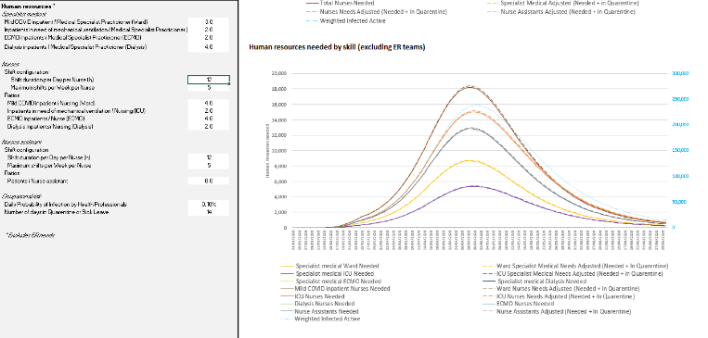
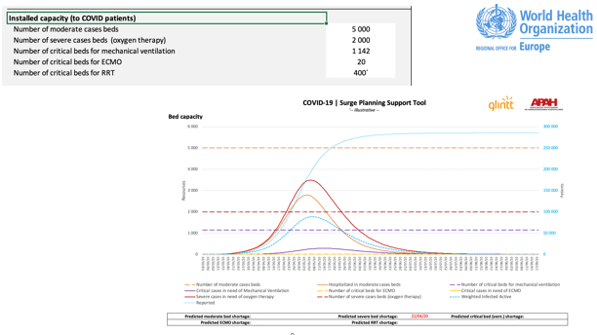
Adappt example outputs

Slide 8
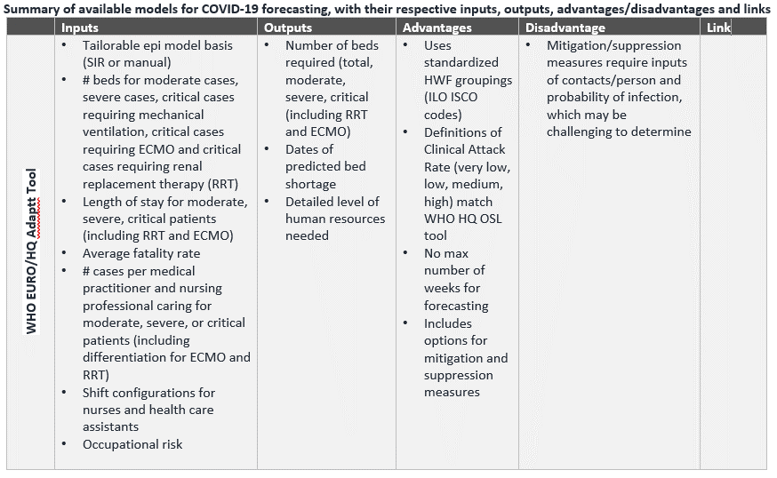

Slide 9
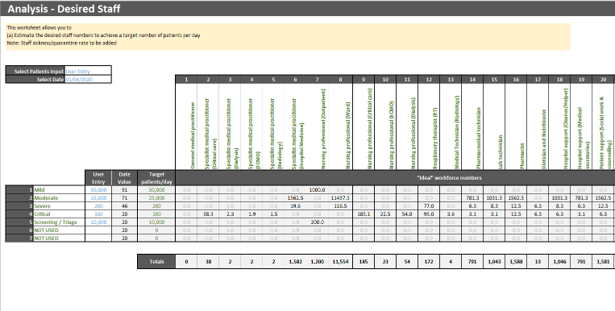
COVID-19 Workforce Estimator

Slide 10
HWFE Outputs
The HWFE tool provides an estimate, based on user data,
of the required number of each type of health worker based
on target number of mild/moderate/severe/critical patients/day.
It also provides an analysis of the throughput of mild/moderate/severe/critical patients in multiple facilities and highlights workforce gap in each type of health worker.

Slide 11
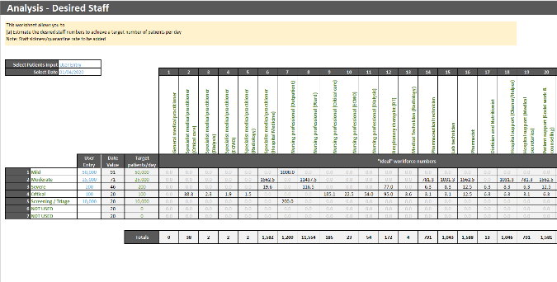
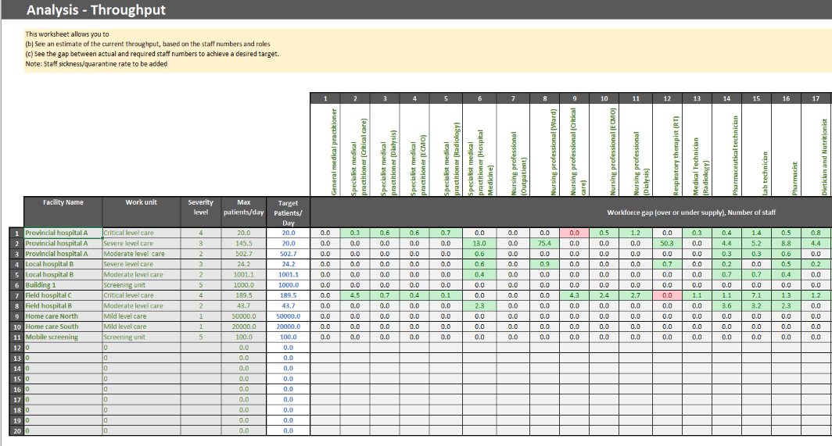
HWFE example outputs

Slide 12
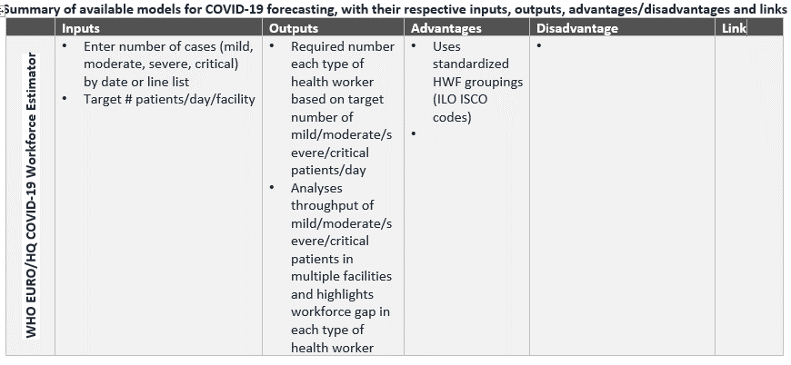

Slide 13
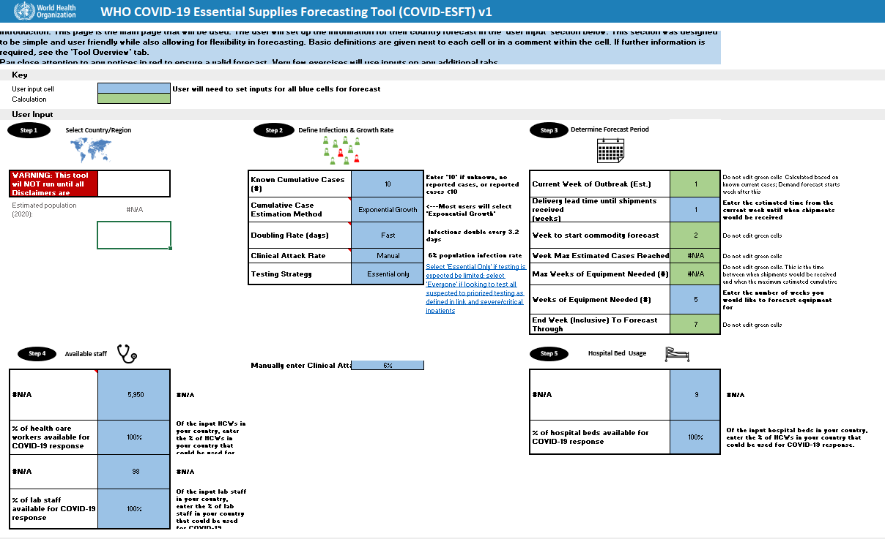
WHO COVID-19 Essential Supplies Forecasting Tool

Slide 14
ESFT Outputs
The ESTF is intended to focus on essential supplies and provides specific focused outputs such as;
  Detailed equipment quantification (PPE, diagnostics, biomedical equipment, drugs and consumables)
  Inpatient beds (total, severe, critical)
  Tests (mild and suspected/severe and critical)
The tool also provides some out put on COVID-19 cases and HWF requirements, including CHW, in an aggregated format.

Slide 15
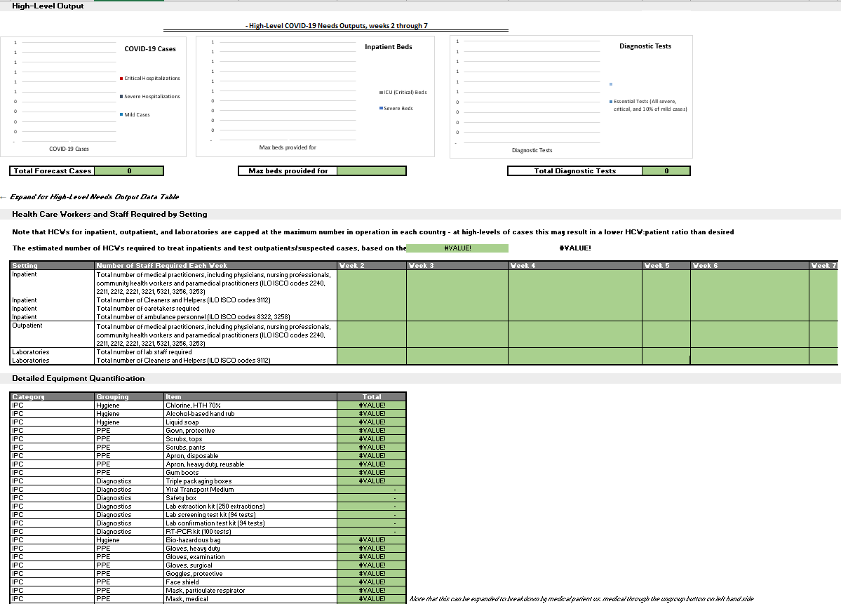
ESFT example outputs

Slide 16
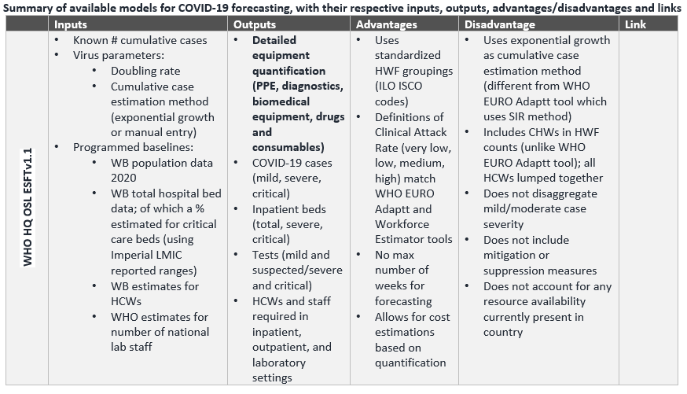

Slide 17








Thank you
WHO Regional Office for Europe
UN City
Marmorvej 51
Copenhagen Ø
Denmark
WHO_Europe
facebook.com/WHOEurope
instagram.com/whoeurope
youtube.com/user/whoeuro
Cris Scotter | Snr Advisor / Consultant | DSP

